Slide 1

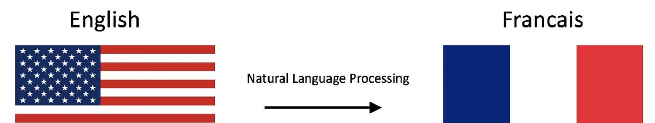

English-to-French Language Translation using Seq2Seq Modeling
This project explores the use of Sequence-to-Sequence (Seq2Seq) modeling for translating English text to French. The team consists of Muhammad Hasnain Raza 011, Muhammad Khizar 027, and Muhammad Haseeb 033, who have worked together to develop and evaluate the translation model.

Slide 2
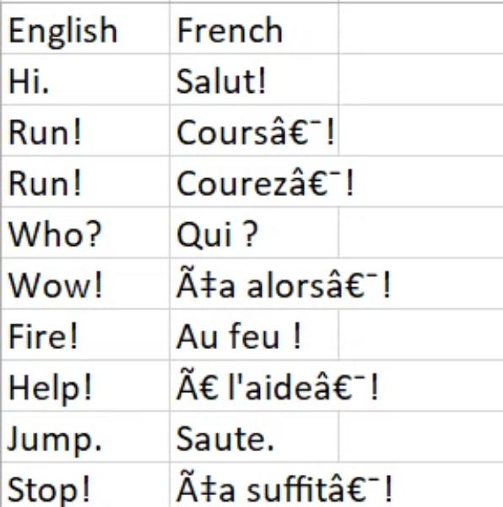

Dataset
The team used the Language Translation (English-French) dataset from Kaggle, which contains parallel text in English and French. The dataset provides a valuable resource for training and evaluating the Seq2Seq translation model.
Dataset Used :

Slide 3

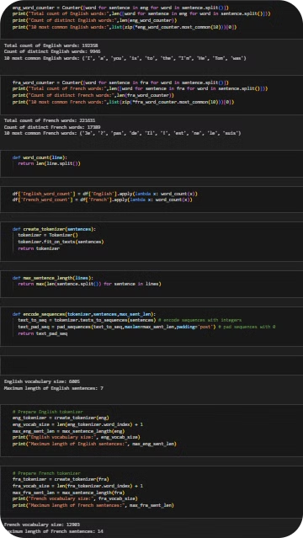
Data Preprocessing
1
Data Loading and Exploration
The data is loaded from a CSV file and basic exploration is performed to analyze the structure and characteristics of the dataset.
2
Preprocessing Functions
Several functions are defined to handle tasks like word counting, tokenizer creation, and sequence encoding.
3
Vocabulary and Sentence Length
The team calculates the vocabulary sizes and maximum sentence lengths for both English and French to prepare the data for the Seq2Seq model.

Slide 4
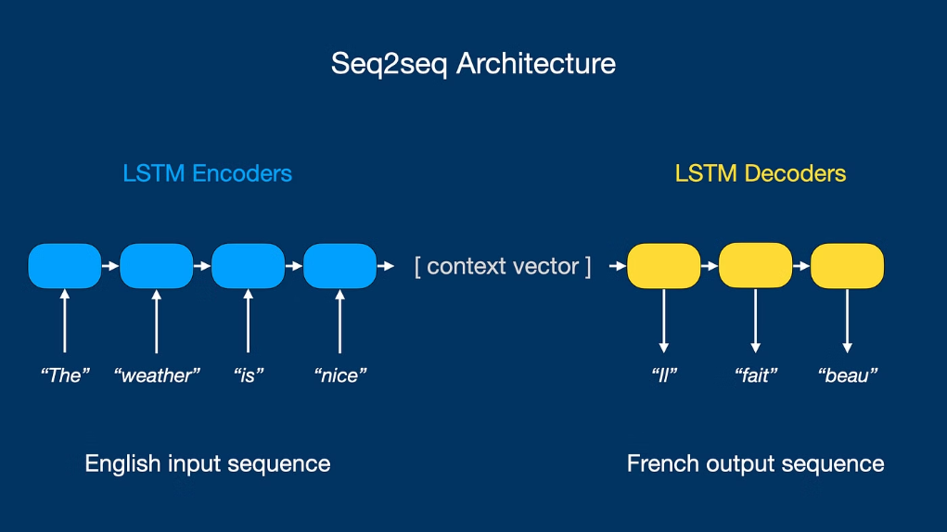
Sequence-to-Sequence Modeling
Encoder-Decoder Architecture
Task and Applications
Model Training
Seq2Seq models are widely used for tasks involving sequential data, such as machine translation, text summarization, and dialogue generation.
The team trains the Seq2Seq model on the preprocessed English-French dataset, optimizing its performance through iterative adjustments.
The Seq2Seq model consists of an encoder that processes the input sequence and a decoder that generates the output sequence.

Slide 5




Training Metrics And Test Metrics
81.25%
1.33%
TRAINING ACCURACY
TRAINING LOSS
80.23%
1.54%
TEST ACCURACY
TRAINING LOSS

Slide 6

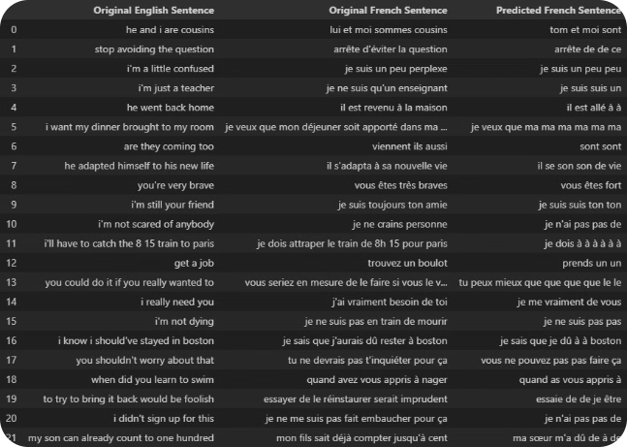
Model Evaluation
1
Training Metrics
The model achieves an impressive accuracy of 81.25% and a low loss of 1.33% during the training phase.
2
Test Metrics
On the test set, the model demonstrates a 80.23% accuracy and a 1.54% loss, indicating strong generalization performance.
3
Robustness and Potential
The model's performance suggests it can effectively translate English text to French, both in training and real-world scenarios.

Slide 7
Conclusion
Impressive Performance
Generalization Capability
The translation model shows excellent results in both training and testing, with high accuracy and low loss.
The model maintains robust performance on unseen data, demonstrating its potential for real-world applications.
Future Opportunities
Team Collaboration
The successful development of this Seq2Seq model opens up opportunities for further research and improvements.
The project showcases the effective teamwork of Muhammad Hasnain Raza 011, Muhammad Khizar 027, and Muhammad Haseeb 033.

Slide 8


Any Questions?
Questions
Discussion
The team is open to addressing any questions or concerns about the Seq2Seq translation model and its development.
The team welcomes further discussion and feedback to enhance the project and explore future improvements.

